Slide 1
HTTPie
Roman Kniazevych
Levi9
collaboration with ChatGPT
Notes:
І для чого нам щось нове? Postman чи curl - це ж було уже!

Slide 2
Benefit of desktop versions

Slide 3
Benefit? (HTTPie vs Postman)
 | Postman | HTTPie
User Interface & Ease of Use | graphical user interface (GUI). More accessible to users who prefer not to use the command line. Beginner-friendly graphical interface. Drag-and-drop features, build complex requests without much technical knowledge. | command-line interface (CLI). Requests from the terminal in a human-readable format. Simplifies making requests with intuitive syntax and is more lightweight for quick operations

Slide 4
Benefit? (HTTPie vs Postman)
 | Postman | HTTPie
Feature Set | Full-featured, with advanced capabilities like API collections, automated testing, environment management, and team collaboration. Supports request chaining, where you can pass the response from one request as input for another. Built-in support for variables, making it easier to work with different environments (development, production, etc.). Suitable for both simple and complex workflows. | Lightweight and fast for simple requests. Supports HTTP methods (GET, POST, PUT, DELETE, etc.) and JSON by default. Great for scripting and automating requests. Minimalistic and focuses on HTTP communication.

Slide 5
Benefit? (HTTPie vs Postman)
 | Postman | HTTPie
Automation & Scripting | Also supports automation via its Newman command-line tool. It can be used to run Postman collections as part of CI/CD pipelines. | Well-suited for automation as it's terminal-based and can be easily integrated into scripts, CI/CD pipelines, etc

Slide 6
Benefit? (HTTPie vs Postman)
 | Postman | HTTPie
Extensibility | Offers a wide range of integrations (Slack, Jenkins, GitHub, etc.) and supports plugins for extending its functionality. It also offers an API for automation and reporting. | Supports plugins and extensions to add new features, but it remains mostly focused on making HTTP requests.

Slide 7
Benefit? (HTTPie vs Postman)
 | Postman | HTTPie
Extensibility | Although GUI-based and easy for beginners, some of the more advanced features (testing, scripting) may take time to master. | Has a lower learning curve for developers already familiar with command-line tools. It’s very intuitive for simple API requests.

Slide 8
Benefit? (HTTPie vs Postman)
 | Postman | HTTPie
Platform | Available as a desktop application for Linux, macOS, and Windows, as well as a web app. | Cross-platform and runs in the terminal on Linux, macOS, and Windows. Recently, a HTTPie Desktop app with a GUI has also been launched to provide a graphical interface.

Slide 9
Benefit? (HTTPie vs Postman)
 | Postman | HTTPie
Use Cases | Better suited for more complex API testing, development workflows, and team collaboration where GUI-based interactions, automated testing, and API monitoring are required. | Ideal for developers who prefer command-line tools or need a lightweight, fast tool for simple HTTP requests.

Slide 10
Benefit? (HTTPie vs Postman)
 | Postman | HTTPie
Use Cases | Better suited for more complex API testing, development workflows, and team collaboration where GUI-based interactions, automated testing, and API monitoring are required. | Ideal for developers who prefer command-line tools or need a lightweight, fast tool for simple HTTP requests.

Slide 11
Benefit? (HTTPie vs Postman)
 | Postman | HTTPie
Conclusion | Choose if: You prefer a GUI and want to create complex workflows and API tests. You're working in a team and need collaboration, API monitoring, and testing features. | Choose if: You prefer working in the command line and need a fast, minimalistic tool. You want a tool for scripting or quick API requests without much overhead.
Notes:
Рухаємось дальше

Slide 12
Benefit of terminal versions

Slide 13
Benefit? (HTTPie vs cUrl)
 | cUrl | HTTPie
Ease of Use | More versatile but has a steeper learning curve. It offers powerful options and flexibility, but the syntax can be hard to remember for complex use cases. Output is plain, so it may require additional processing (e.g., piping to jq for pretty-printing JSON). | Designed to be human-friendly and easy to use, with intuitive syntax that simplifies working with APIs. HTTPie provides colored output and automatic formatting of JSON responses, making it easier to read the output.
Notes:
Рухаємось дальше

Slide 14
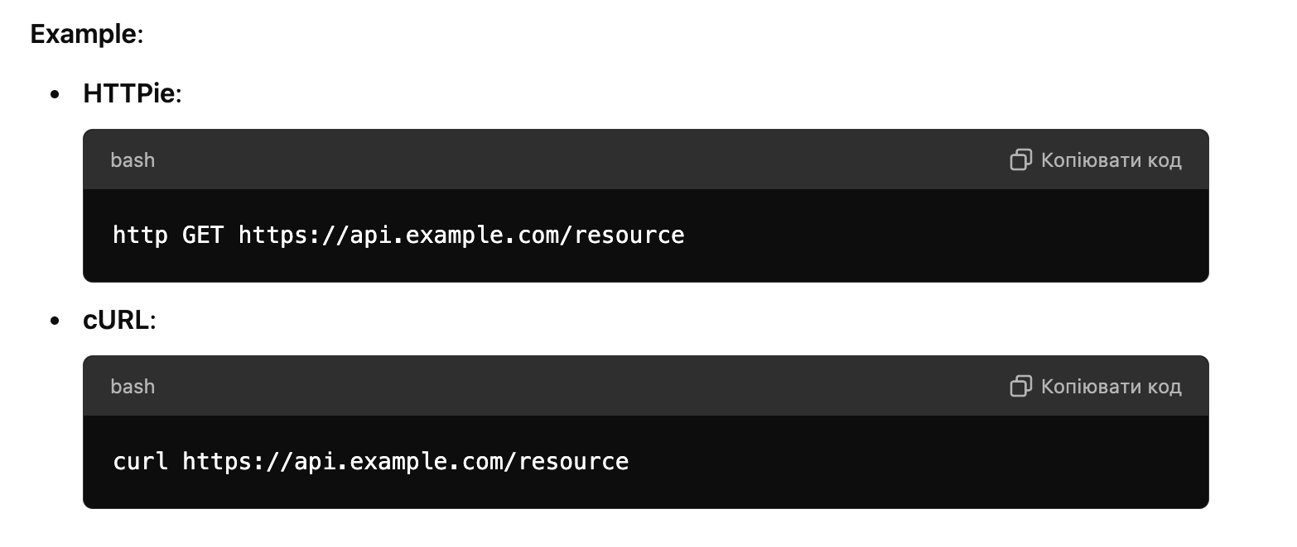
Benefit? (HTTPie vs cUrl)
Ease of Use
Notes:
Рухаємось дальше

Slide 15
Benefit? (HTTPie vs cUrl)
 | cUrl | HTTPie
Output Formatting | Automatically formats JSON output and uses color-coding, making the response more readable by default. | Does not automatically format the output; it's displayed raw. Users often pipe the output to utilities like jq for better readability.
Notes:
Рухаємось дальше

Slide 16
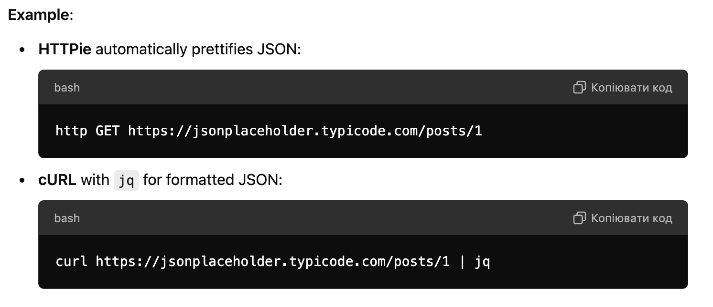
Benefit? (HTTPie vs cUrl)
Output Formatting
Notes:
Рухаємось дальше

Slide 17
Benefit? (HTTPie vs cUrl)
 | cUrl | HTTPie
Syntax Simplicity | Offers a more complex and flexible syntax, requiring the use of flags for almost every option. This gives you more control, but also makes it more verbose. | Designed with a simple syntax that closely resembles natural language, making it intuitive for users.
Notes:
Рухаємось дальше

Slide 18
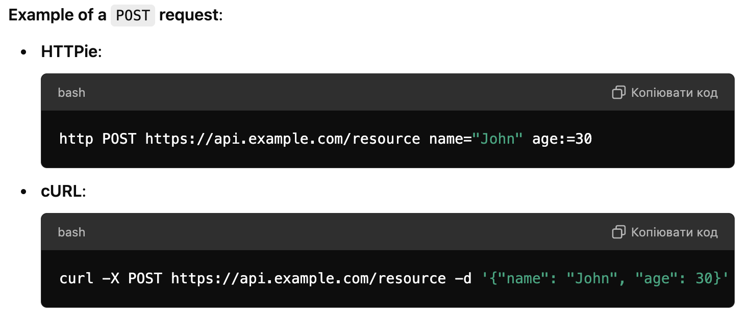
Benefit? (HTTPie vs cUrl)
Syntax Simplicity
Notes:
Рухаємось дальше

Slide 19
Benefit? (HTTPie vs cUrl)
 | cUrl | HTTPie
Feature Set and Flexibility | Extremely versatile. In addition to HTTP, it supports FTP, SFTP, SCP, SMTP, POP3, and many other protocols. It is often the go-to tool for network operations beyond HTTP. | Focuses primarily on HTTP. It has some advanced features like handling JSON by default, sending form data easily, and automatic basic authentication handling. However, it doesn't match cURL's flexibility for non-HTTP protocols.
Protocol Support | Supports multiple protocols including FTP, SFTP, SMTP, POP3, etc., making it much more flexible for network-related operations beyond web APIs. | Primarily designed for HTTP/HTTPS requests.
Customization | Highly customizable with a huge number of flags to fine-tune almost every aspect of your requests, from headers to retry policies and more. | Focused on providing a consistent, human-readable experience, so it has fewer customization options. However, it supports plugins.
Notes:
Рухаємось дальше

Slide 20
Benefit? (HTTPie vs cUrl)
 | cUrl | HTTPie
Learning Curve | Steeper learning curve, especially when working with advanced features, but it is extremely powerful for those who need precise control over their requests. | Low learning curve, ideal for users who want to make simple HTTP requests quickly without delving into detailed syntax.
Installation and Platform | Almost always pre-installed on Linux and macOS, and easily available on Windows. | Available on most platforms (Linux, macOS, Windows), but not as universally pre-installed as cURL.
Scripting and Automation | Frequently used in scripting and automation. Its comprehensive set of features and options allows it to handle a wide range of tasks in scripts, such as file transfers, data manipulation, and web scraping. | Simpler for human use but can still be used in scripts for basic HTTP interactions. It is less widely used in complex automation due to its simplicity and focus on usability.
Notes:
Рухаємось дальше

Slide 21
Benefit? (HTTPie vs cUrl)
 | cUrl | HTTPie
Authentication | Can handle all forms of authentication but typically requires more detailed syntax. | Simplifies the process of passing authentication tokens or credentials. It supports basic authentication (-a flag), bearer tokens, and others more intuitively.
Notes:
Рухаємось дальше

Slide 22
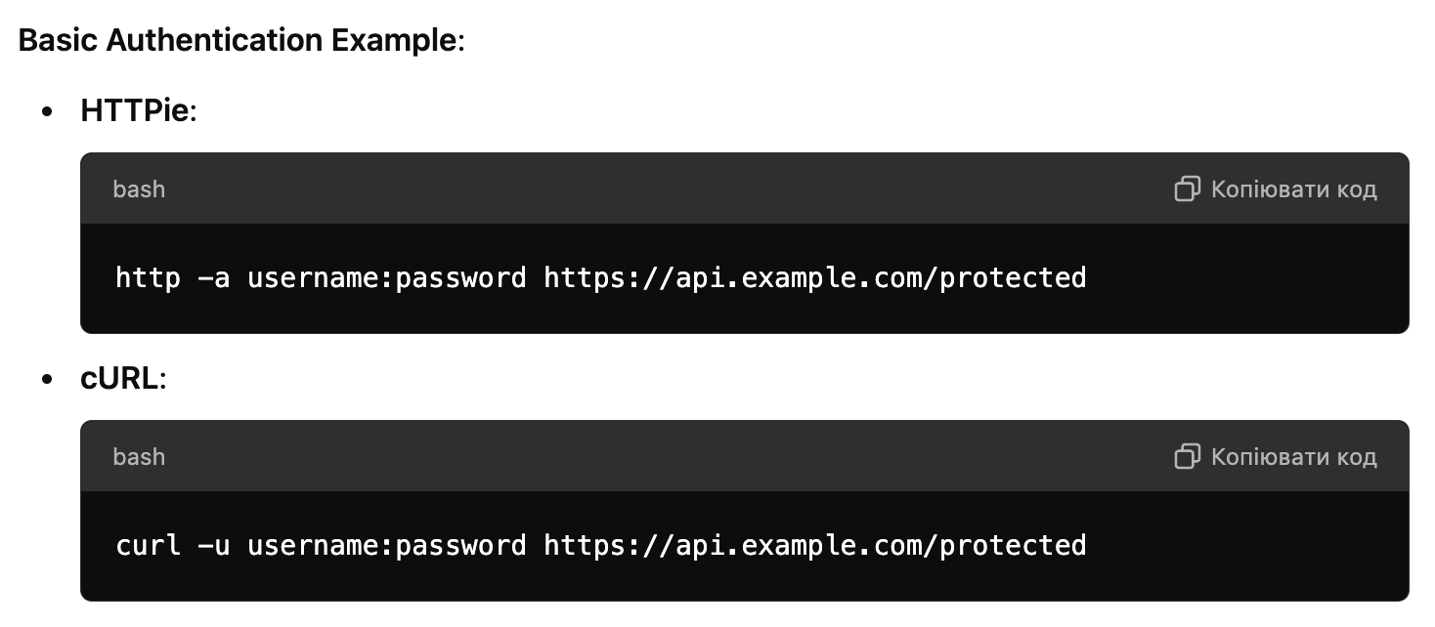
Benefit? (HTTPie vs cUrl)
Authentication
Notes:
Рухаємось дальше

Slide 23
Benefit? (HTTPie vs cUrl)
 | cUrl | HTTPie
Conclusion | Use if: You need a versatile tool that supports multiple protocols (FTP, SCP, SMTP, etc.) in addition to HTTP. You require detailed control over every aspect of the HTTP request (headers, timeouts, retries, etc.). You’re looking for a robust tool for scripting and automation, especially in network administration or CI/CD pipelines. | Use if: You want a human-friendly tool for interacting with web APIs and prefer clean, readable output. You primarily work with HTTP/HTTPS and need a lightweight, easy-to-use solution. You need to quickly debug or test RESTful APIs.
Notes:
Рухаємось дальше

Slide 24
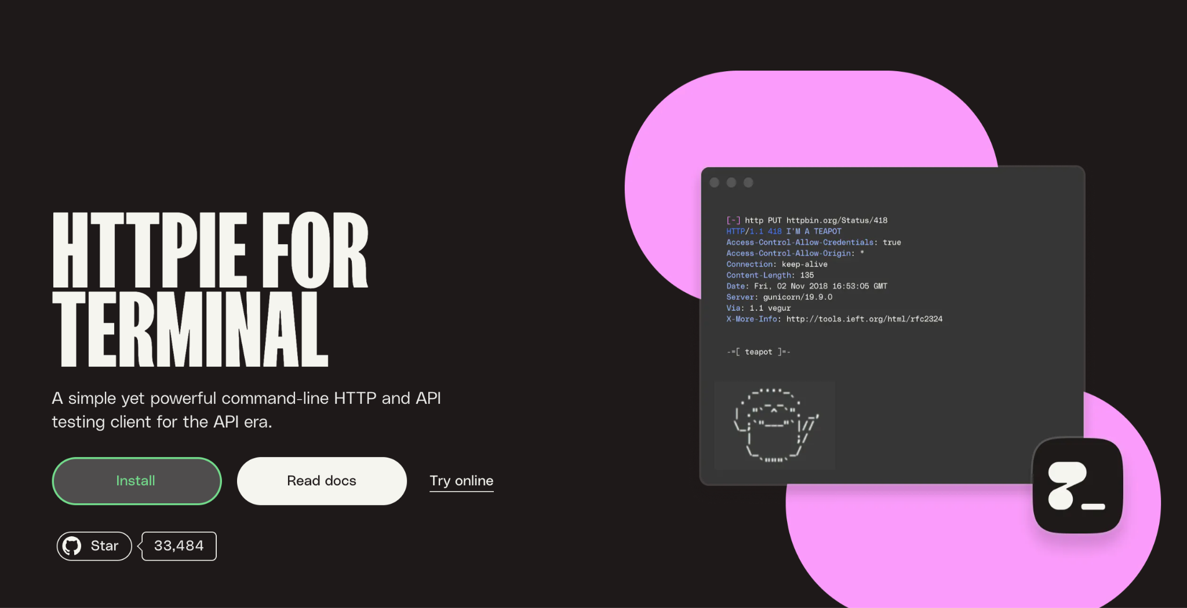

Slide 25
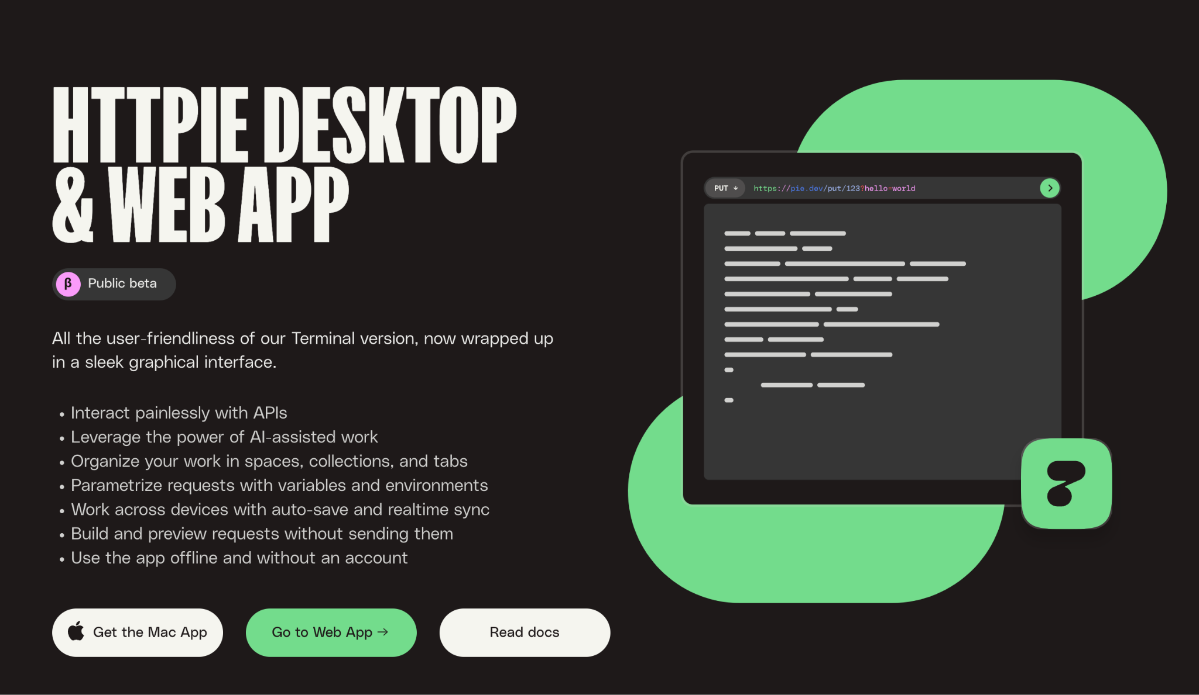

Slide 26
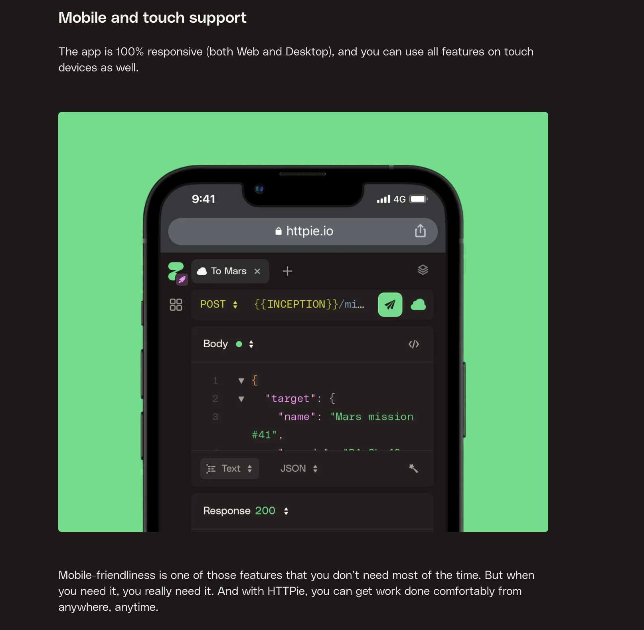

Slide 27
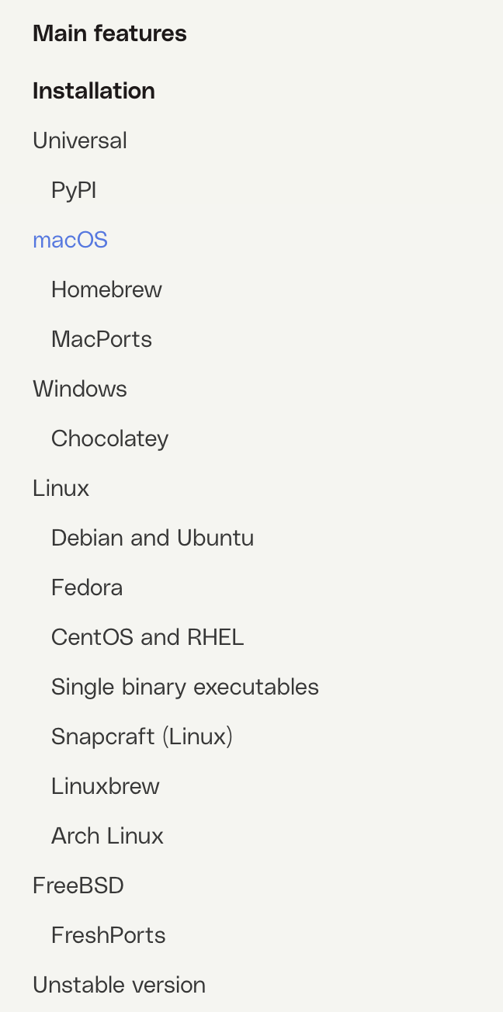
HTTPie CLI

Slide 28
DEMO

Slide 29
My Conclusion
I would definitely use this HTTPie tool on a new project
Nice to have 3 tools in one.
Desktop features not so powerful as Postman has
Terminal cli not versatile - but does dev need it?
…

